Slide 1



BSP6
A deep learning-based method for Hate speech detection on social media content
Author: André Dussing

Slide 2
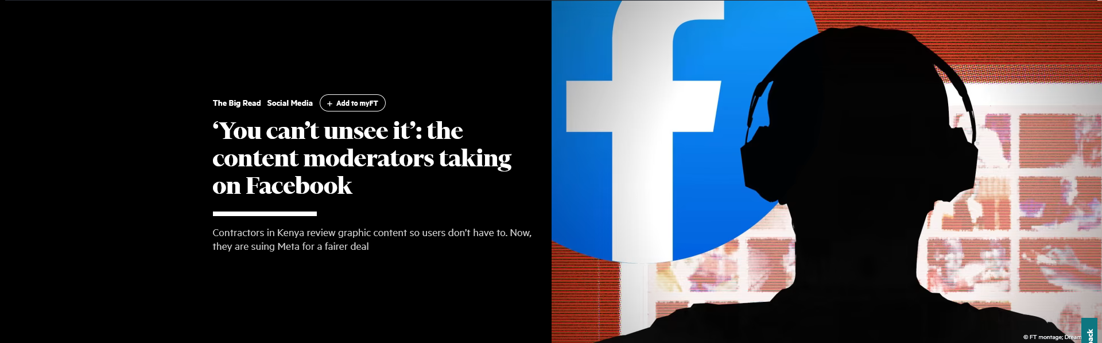
Effects of hate speech on social media
Problem ?
hate speech is likely to result in actual harm to those who are being targeted
negative impacts on your mental health and wellbeing as well as limiting your ability to connect with people and participate online.
Moderation

Slide 3
Moderation: The golden middle ground
Allowing Hate speech
Limiting Free Speech
Intelligent classification method, which understands Language and the context of the discussion.

Slide 4
NLP Classifier =BERT
BERT stands for Bidirectional Encoder Representations from Transformers.
Developed by Google in 2018, it is a state-of-the-art model used in natural language processing tasks such as language understanding and sentiment analysis.
BERT differs from traditional models by reading the entire sequence of words at once, allowing it to understand the context and nuances better (Bidirectional context).
Its transfer learning capabilities allow us to fine-tune the pre-trained model on our specific task (hate speech detection), making it a very efficient approach.
Different pre-trained models

Slide 5
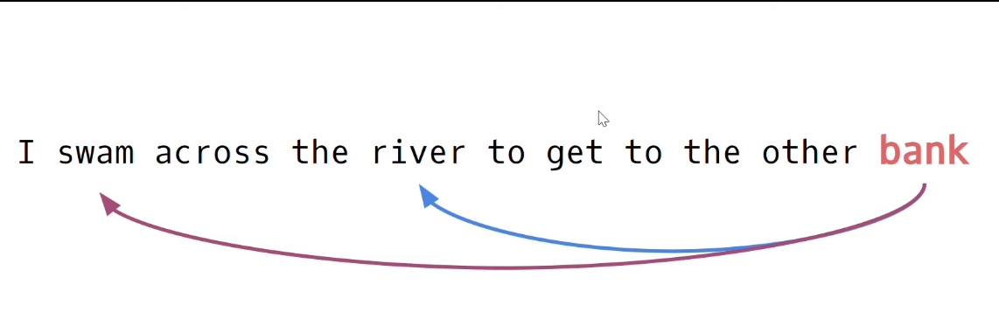
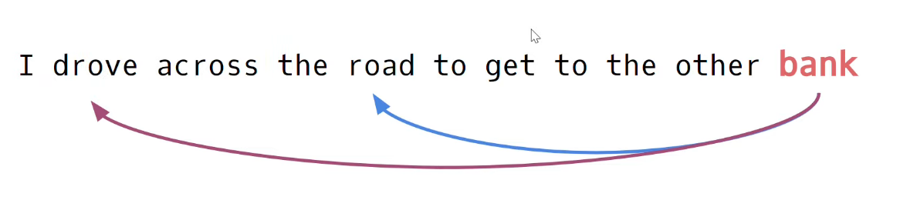
Context maters!
Bank =sloping raised land
Bank =Financial institution

Slide 6
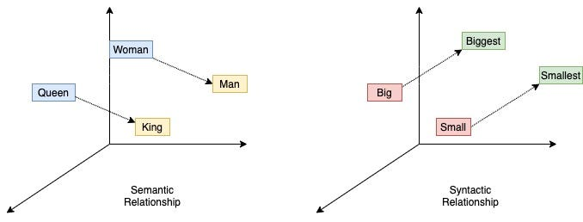
Word/Tokens as Embeddings
For example, Word2Vec embedding

Slide 7
v₁
v₁
v₁
v_{n}
Word vectors
Self-attention mechanism
Weigh vectors according to their context
Contextualized representation of
Word vectors
y₁
y₁
y₁
y_{n}

Slide 8
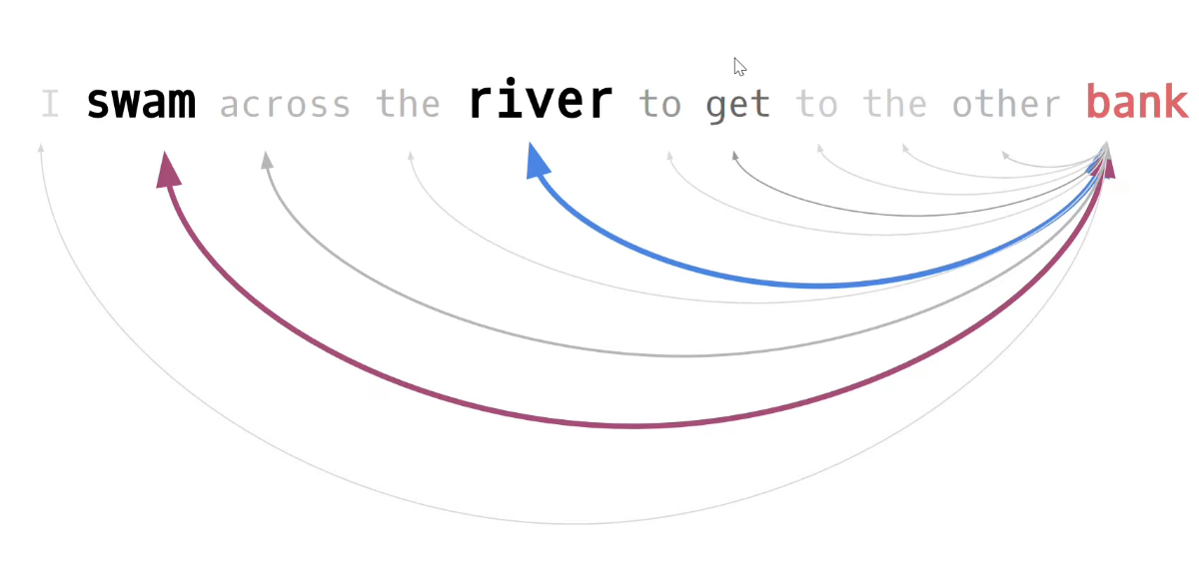
Self-attention mechanism:

Slide 9
Dataset for our model to train
Social media site (Reddit)
Should contain contextual information
an existing dataset form the paper "Hate Speech and Counter Hate Speech Detection

Slide 10
Time to dive into the code….

Slide 11
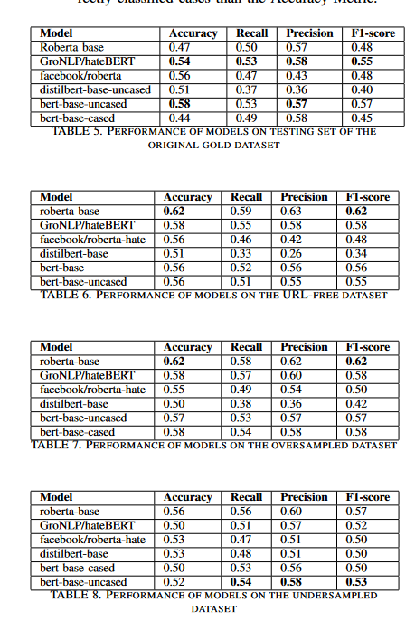
Results
Models
Distell Bert too simple for our task
14% performance boost by pre-processing
1% performance boost by hyper-parameter search
Roberta seems to be a good choice
Models with vocabulary knowledge from that domain did not stand out
Own hate speech classifier

Slide 12
Future Work
How can this project be improved or extended?
Adding new information to the dataset such as usernames/User IDs
Train multiple models and then use voting or stacking for the final prediction

